Slide 1
بسم الله الرحمن الرحيم Faculty of Engineering Computer Engineering Department Softwere project SAKAN-University Housing Services
Done by
Yousef Habbabeh
Haitham Ajaj
Huthayfah Amer
Supervisor
Dr. Yacoub Sabaten

Slide 2
Introduction
It is difficult to university student to find appropriate residence to live during his university study period especially first-year students, in the traditional way the student have to ask people to know who has a house for rent, at the same time the house owner may have difficulty in finding tenants and marketing his house, on the other hand, a student may have vacant room in his house and need another student to live with him to reduce the rental cost, for this many reasons it must be a tool to put together each one who interested in university housing taking advantage of the prevalence of smart phones and mobile applications.

Slide 3
Introduction
Our project is an application for android mobiles is intended to be used by the university students who looks for a home to live and homes owners to post their homes advertisements, the application provide the basic functionality that is required such as add/view homes, receive notifications, and profile management.

Slide 4
Suggested Solution
To solve this problem we have implemented a mobile application which is a good and easy tool to use instead of search manually by asking peoples or other ways, it will solve the problem of misunderstanding of home specification by provide a detailed description of each advertised home, and will help students who need a part of home, and help the problem of marketing, and using this application will not need any effort, and today internet is everywhere.

Slide 5
Realization & Implementation
Functional Requirements
The electronic leasing application will provide the user with the ability to perform some services in an organized and easy way without exerting much effort as soon as possible.
Sign in: the user if he has an account (email and password) he’s can sign in directly but if not he’s need to create an account to can sign in to application.
Create an user account: he can create throw create password and email and personal information’s and then he can sign in .
User added home: the user can add a home to Leasing It throw Check box views the information to and fall this information and submit to show and leasing it.
Leasing a home: the user can Leasing a home by application after viewed the home to Tenant.

Slide 6
Realization & Implementation
User rent a home: the user that want rent a home he can see all homes and request what he wants.
User watch: any user he can watch the houses shown if he can an owner or tenant from viewer list and any visitor to application if he download application .
the user want Rent a home He’s can sort it: when the tenant he request a home and visitor They can sort the homes according specification it like the number of room or price or gender to see what he want quickly.
Change profile settings: if a user he want change he’s information he can do it.
Notifications user: the user receive a notification if he was tenant receive every added a new home and the owner he receive if any one request the the home.

Slide 7
Realization & Implementation
Non-Functional Requirements
Portability
Usability
Availability
Security

Slide 8
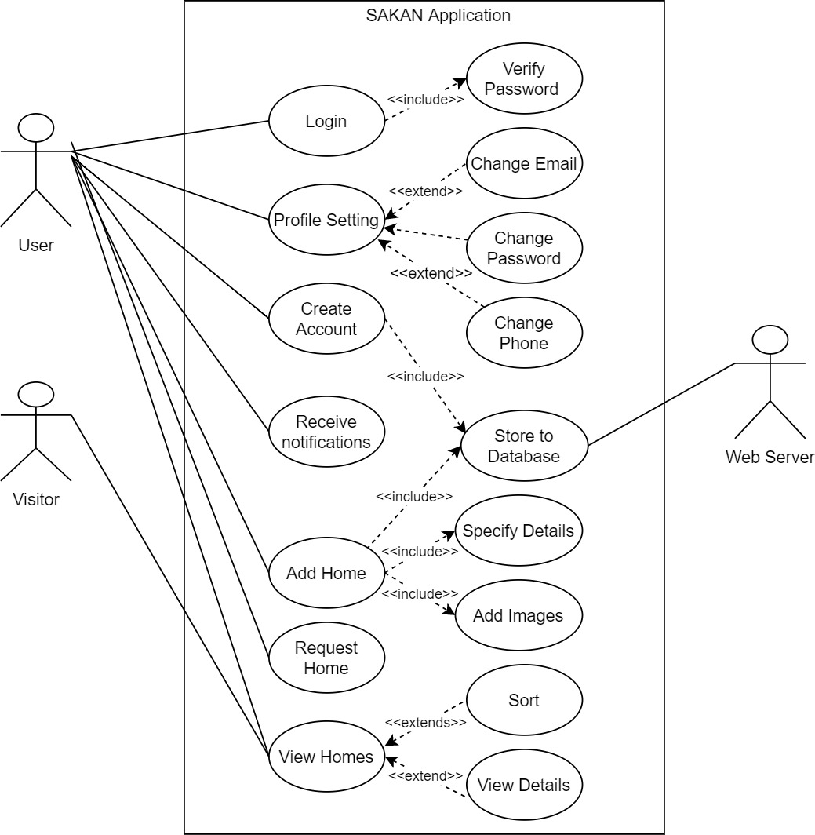
Realization & Implementation
Use case diagram

Slide 9
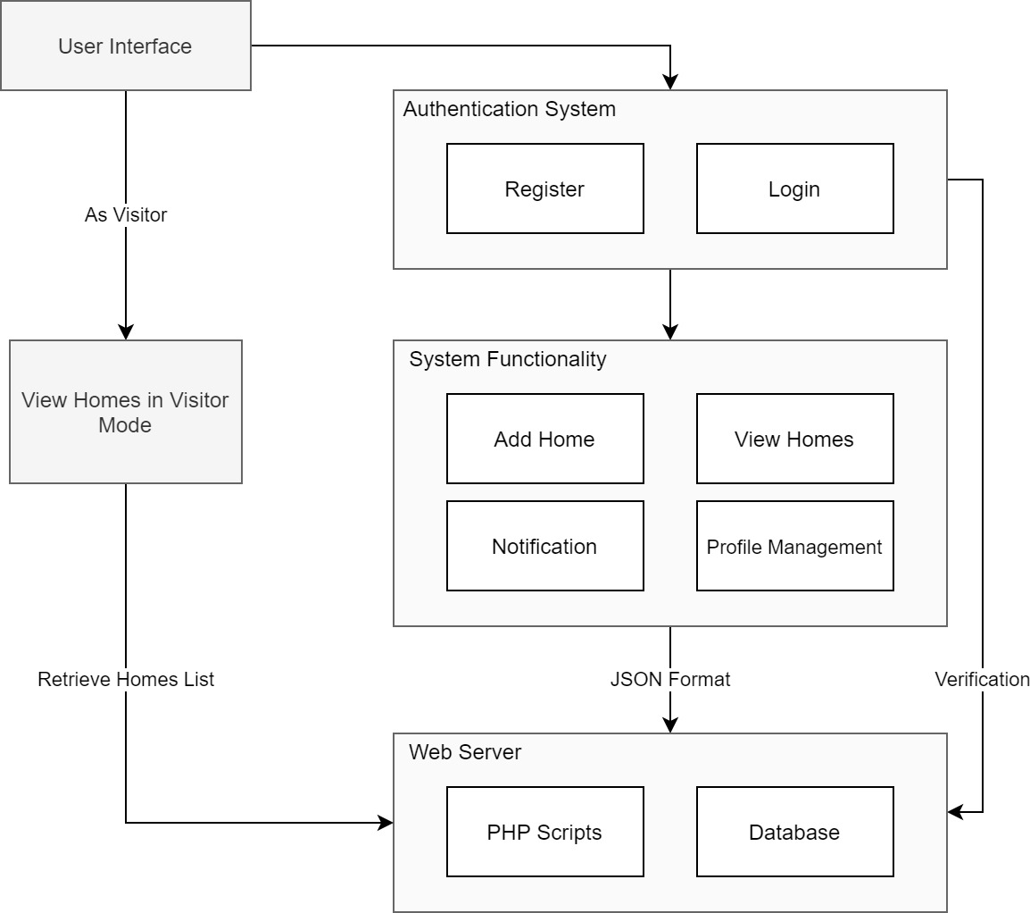
Realization & Implementation
System Architecture:

Slide 10
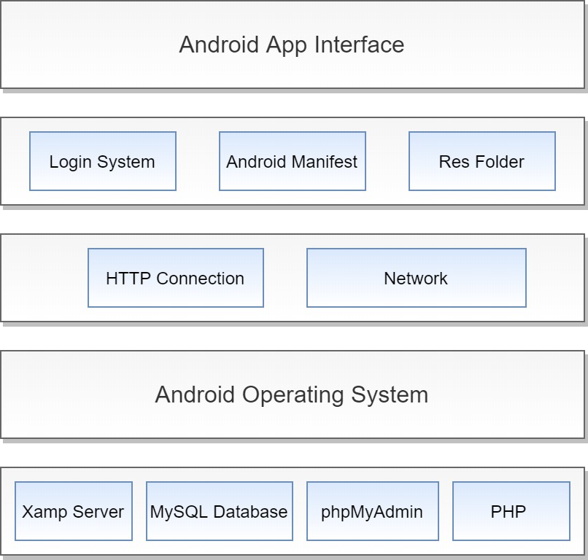
Realization & Implementation
Layered Architecture:

Slide 11
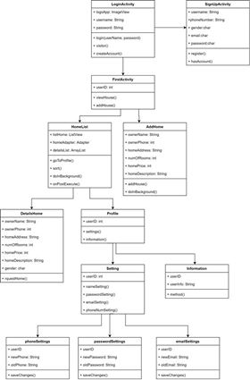
Realization & Implementation
Class diagram

Slide 12
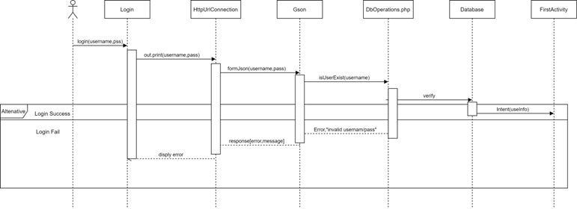
Realization & Implementation
Sequence Diagram

Slide 13
Testing & Results
Unit Testing
It is the process of testing individual components in isolation, very line we wrote we checked it directly, the Android studio IDE helped us to do this testing by showing error messages when there is a syntax error, while writing PHP code, the Atom IDE helps us to detect each syntax error and we have used echo command to see the output of each code section.
Component Testing
In this testing, several individual units are integrated together to test it as a whole component, we applied this in interfaces design when we combine several screen elements in XML code and run the program to see how it looks on the screen, also when creating the PHP-database connection and executing at least one operation then we need to link files together and test the result.
System Testing
This done when all the system components are integrated and tested as a whole system, it focus on the interaction between the components, we have checked the program after we finished programming it to test the interaction between java and PHP and SQL codes and there is several problems.

Slide 14
Testing & Results
Testing results
As a result for unit testing there is no problems appear, the problems appeared when doing component testing for design when run the application on different screen sizes, this problem solved by using linear layout, another problem appeared when doing connection the database using JDBC driver this problem we cant solve because the android studio wasn’t support the driver version (OJDBC6) so we convert the application to connect using web services and PHP, after doing system testing the web-based application we had a lot of errors so we performed some changes to the PHP code, finally some features of the application work properly such adding home and viewing homes and there is problems with other parts such as login and profile settings.

Slide 15
Conclusion & Future work
In conclusion, we want to talk about our project and that we have overcome all the problems that we faced with having some things that we could not accomplish and we hope the project will meet the requirements of it in the labor market and that we will keep pace with the needs of the labor market with thanks and appreciation.

